Slide 1
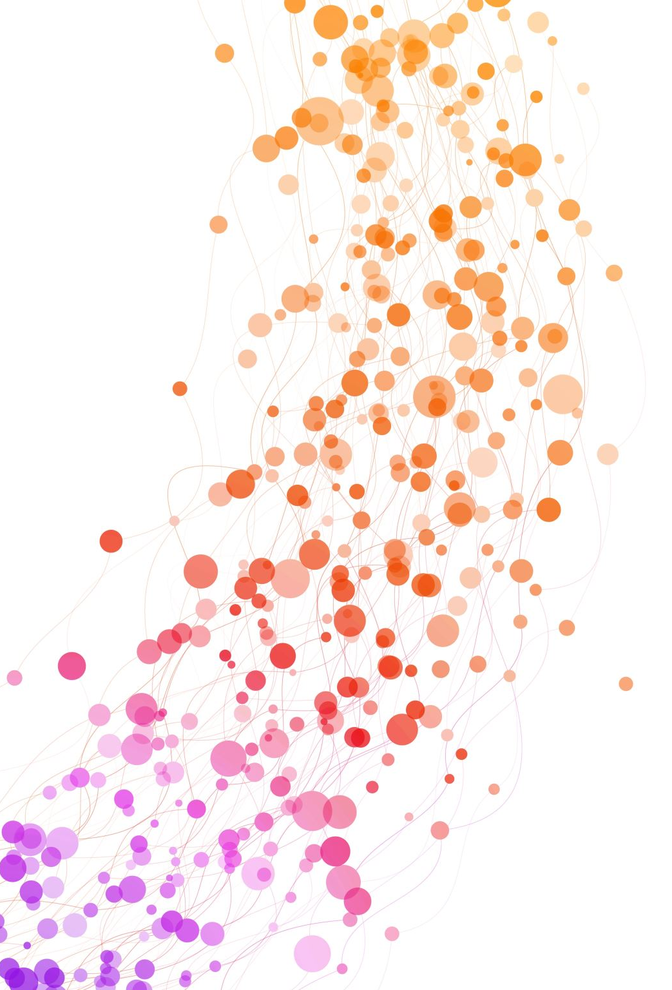
Deep Learning Bootcamp 4
Sequence data and Sequence modeling
Speakers: Alka Luqman & Tu Ngo (CCDS)

Slide 2
Bootcamp Code
Website
www.bit.ly/ntudlb

Slide 3
Sequence data
The data points, or the elements of each data points are arranged in specific sequence / chronological order.
Data points are not isolated, and the order in which they appear matters.

Slide 4
Sequence data includes
Time series
Text
Speech
Music
DNA sequences
Video frames
User clicking

Slide 5
Applications for Textual data
Sentiment Analysis, Spam detection, Topic modeling
Named Entity Recognition
Next word prediction – autocomplete
Text generation, summarization
Machine Translation
Information retrieval, Question answering

Slide 6
How do we represent text?
Tokenization
Let's start learning!
Let
's
start
learning
!

Slide 7
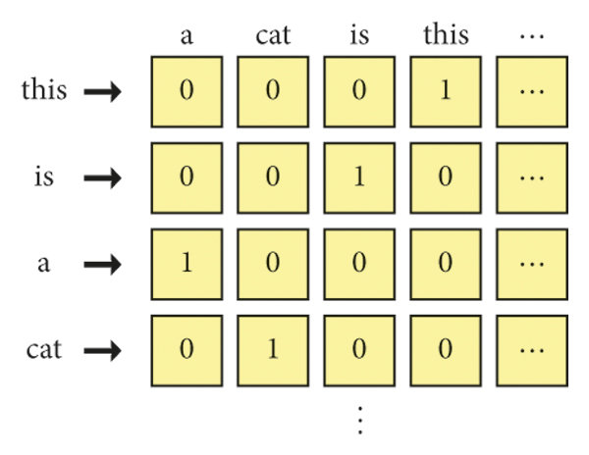
One Hot Encoding
Sentence : This is a cat
VOCABULARY
Sentence : [000100000 001000000 100000000 010000000]

Slide 8
One Hot Encoding
Sentence : This is a cat
Sentence : [000100000 001000000 100000000 010000000]
How long should this vector be?
How frequently should you update the vocabulary?
Synonyms have different vectors

Slide 9
Embeddings
A better way to convey meaning in the vectors itself
Barking = [0.0012 0.1091 0.7386 -0.0105 ]
Static vector
Now we can measure similarity
The
dog
is
barking
in
the
night
Context

Slide 10
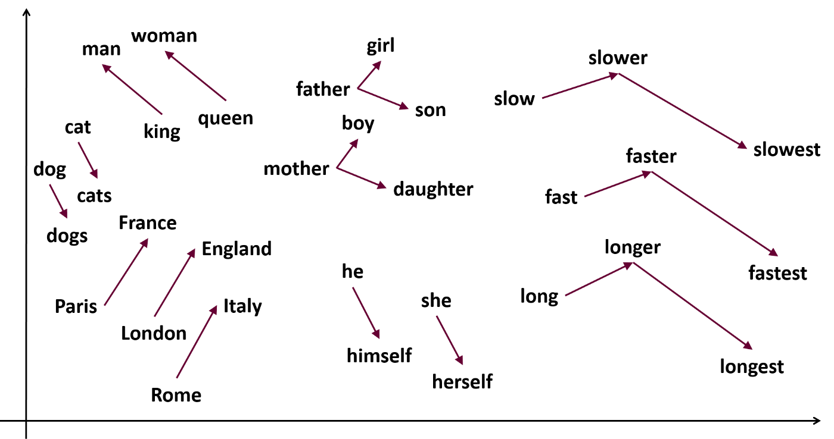
Word2Vec

Slide 11
Next word prediction
Given context predict center word
The
dog
barks
when
I
?
The
dog
barks
when
I
?
on
the
door

Slide 12
Bidirectional Embeddings
Different embeddings for different contexts
The
dog
barks
when
I
knock
on
the
door
The
tree
bark
is
rough
when
I
touch
it

Slide 13
BERT is a model
The embeddings are as good as the training
BERT's primary objective was Masked Language Modeling
I am eating lunch. It tastes [MASK].
BERT's secondary objective was Next Sentence Prediction
I am eating lunch. [???]

Slide 14
BERT tokens
I am eating lunch. It tastes delicious.
i
am
eating
lunch
.
it
tastes
delicious
.
Token embeddings
101
40
939
1570
1748
13
102
480
47844
19134
13
102
[CLS]
[SEP]
[SEP]
Position embeddings
0
1
2
3
4
5
6
7
8
9
10
11
Segment embeddings
0
0
0
0
0
0
0
1
1
1
1
1

Slide 15
BERT embedding
101
40
939
1570
1748
13
102
480
47844
19134
13
102
0
1
2
3
4
5
6
7
8
9
10
11
0
0
0
0
0
0
0
1
1
1
1
1

Slide 16
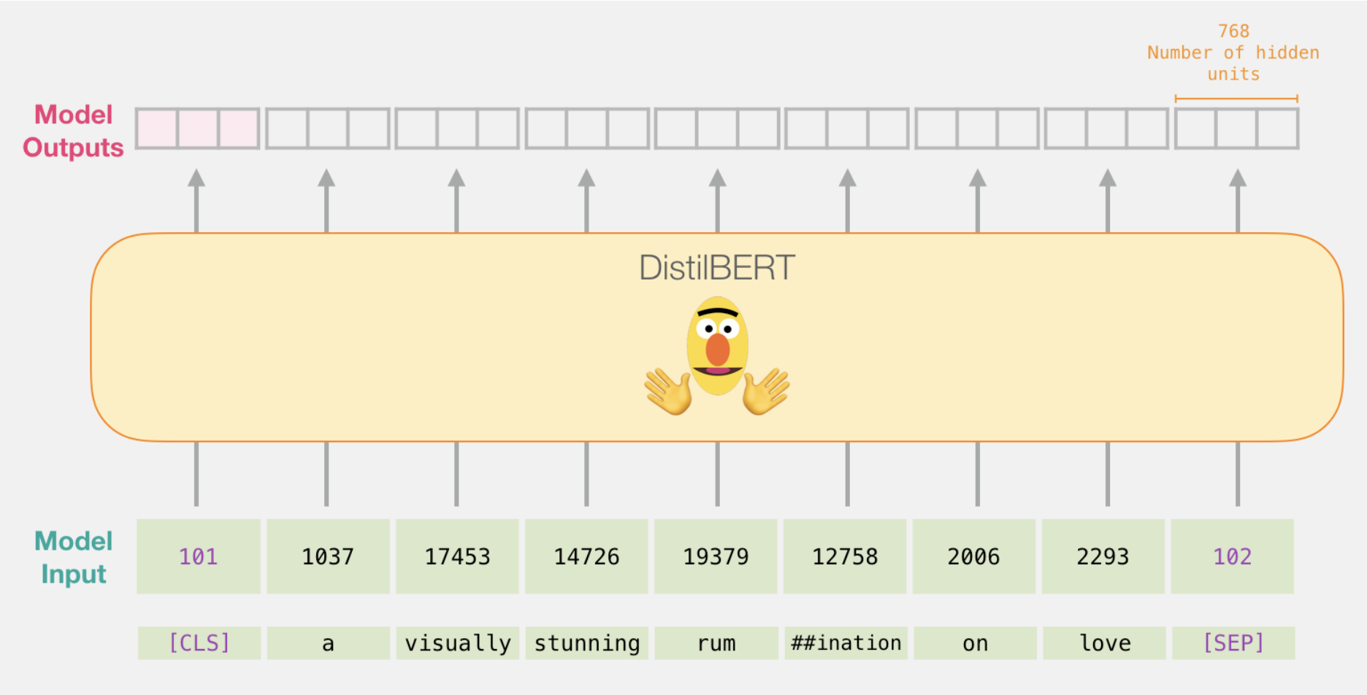
BERT embedding
Notes:
Images from https://jalammar.github.io/a-visual-guide-to-using-bert-for-the-first-time/

Slide 17
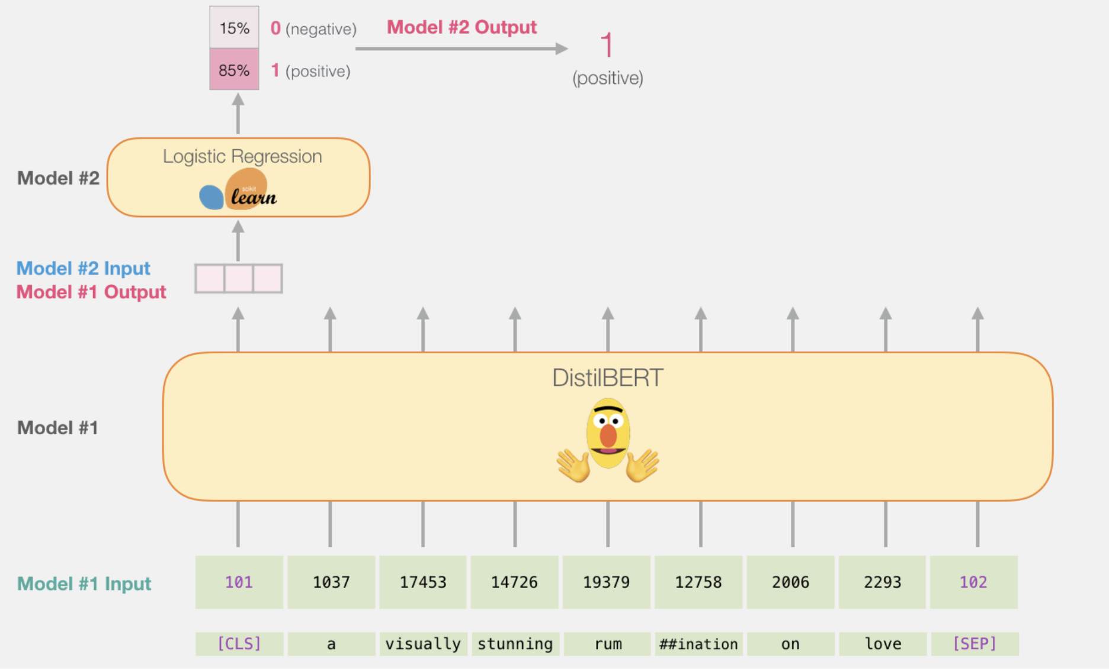
Using BERT embedding for Classification
Notes:
[CLS] token's final embedding is used as the aggregate representation of the entire input

Slide 18
Different BERT models
Multilingual BERT
MedBERT- medical LM understands health records, diseases
LegalBERT – law LM understands legalese, patents
PolyBERT – chemical LM

Slide 19
Sequence modeling

Slide 20

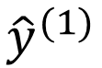
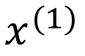
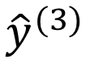
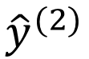
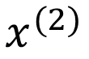
Problems with feed-forward NN
$${\hat{y}}^{(1)}$$
$$x^{(1)}$$
1. No temporal info
$${\hat{y}}^{(2)}$$
$$x^{(2)}$$
$${\hat{y}}^{(3)}$$
2. Fixed input/output size
3. High memory for big input

Slide 21
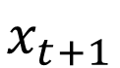
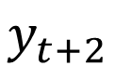
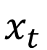
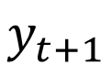
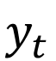
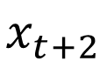
Recurrent neural network
$$y_{t}$$
$$y_{t+1}$$
$$y_{t+2}$$
Cell
Cell
Cell
…
Each cell takes:
Previous cell’s state
Current input token
$$x_{t}$$
$$x_{t+1}$$
$$x_{t+2}$$
NTU
is
awesome

Slide 22
Sequence to Sequence (Seq2Seq)
I
am
a
student
<END>
Encoder
Decoder
Je
suis
étudiant
<START>
I
am
a
student
Machine translation using Seq2Seq

Slide 23
Limitations of RNNs
Information bottleneck
Slow, no parallelization
Struggle to capture long-term memory

Slide 24
We desire something even better…
Information bottleneck Continuous stream
Slow, no parallelization
Struggle to capture long-term memory

Slide 25
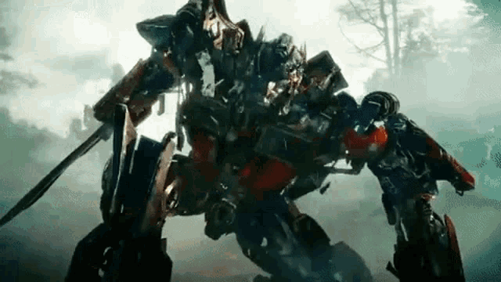
Sequence model evolution
Recurrent networks
Breakthrough!!!
Groundbreaking!!!
Vanila RNN
LSTM
GRU
Transformer
Context = 250-500 words
Context = up to 1k words
Context length :
GPT1 = 512 words
GPT2 = 1024 words
GPT3 = 2048 words
GPT4 = 128k words (>300 pages)

Slide 26
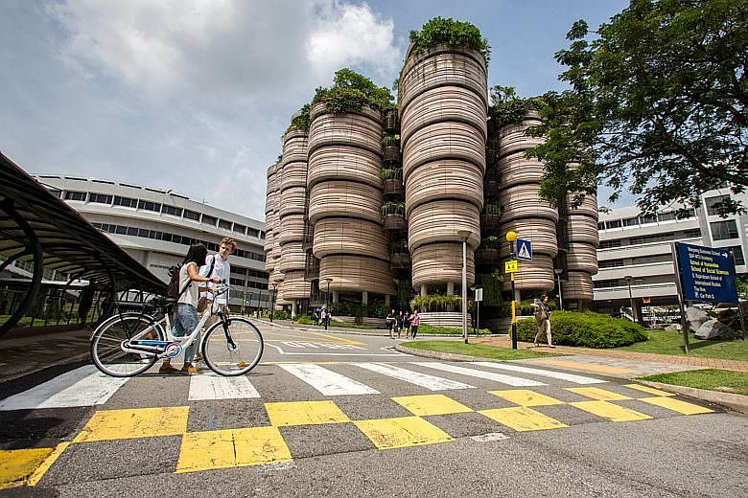
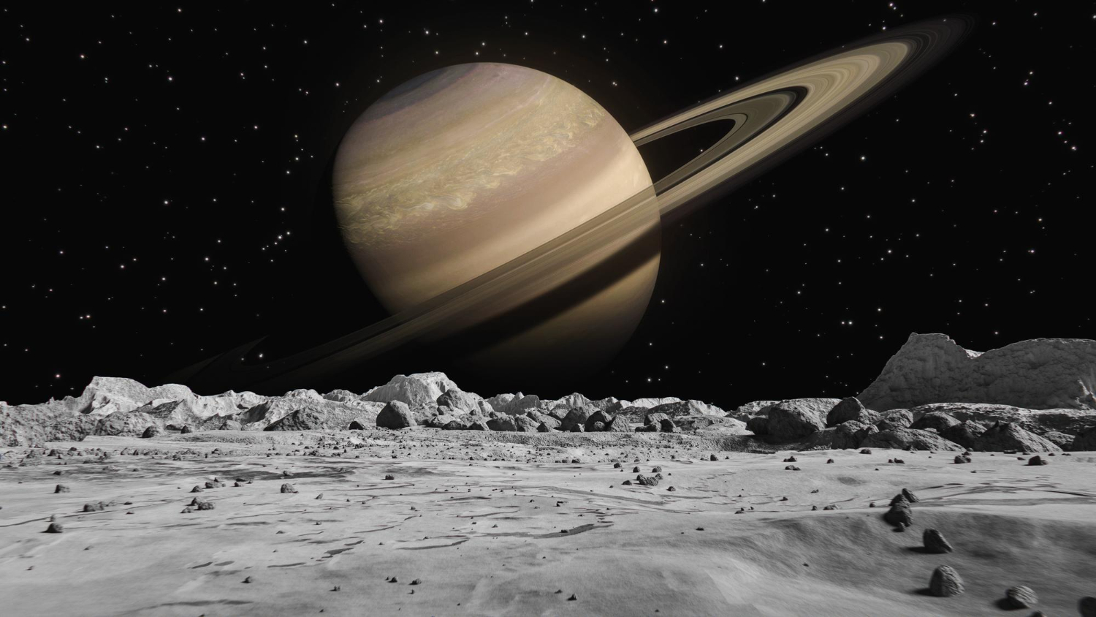
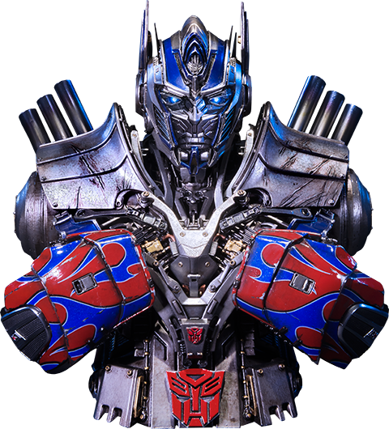

Attention is all you need

Slide 27
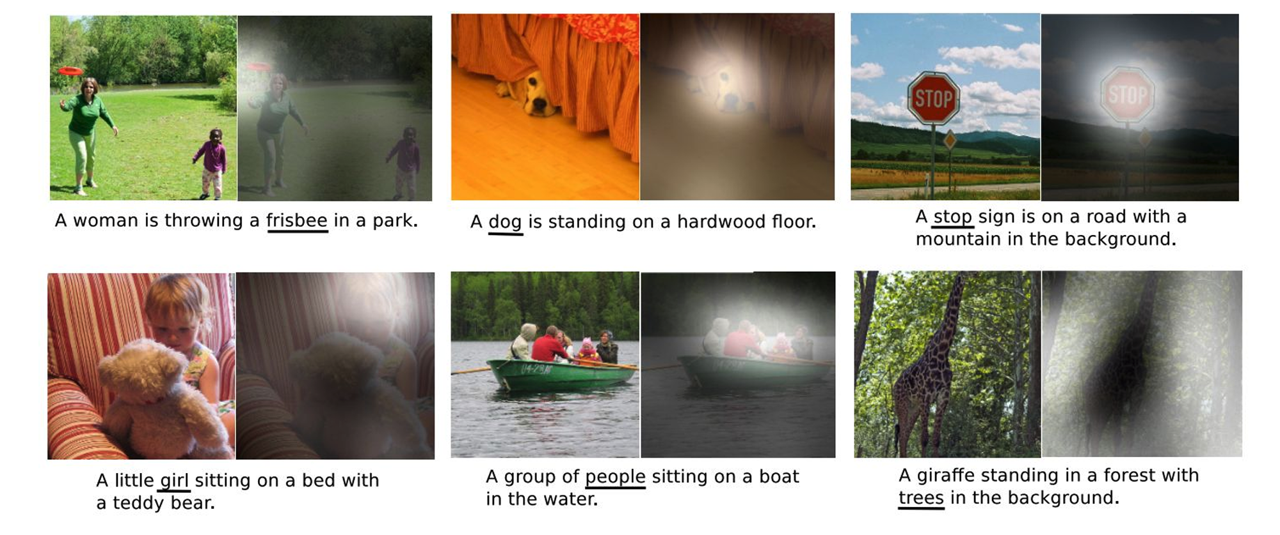
Attention is all you need
Image captioning with Attention

Slide 28
Attention is all you need
Revisit Seq2Seq recurrent network (no attention yet)
I
am
a
student
<END>
Encoder
Decoder
Je
suis
étudiant
<START>
I
am
a
student

Slide 29
Attention is all you need
Looking at the first decoder time step
I
Encoder
Decoder
Je
suis
étudiant
<START>
The last Encoder hidden state is fed to the Decoder

Slide 30
Attention output
Now, try to pay attention!
Probability
distribution
I
Decoder
Encoder
Je
suis
étudiant
<START>

Slide 31
Attention output
Now, try to pay attention!
I
am
Probability
distribution
Decoder
Encoder
Je
suis
étudiant
<START>
I

Slide 32
Attention output
Now, try to pay attention!
I
am
a
Probability
distribution
Decoder
Encoder
Je
suis
étudiant
<START>
I
am

Slide 33
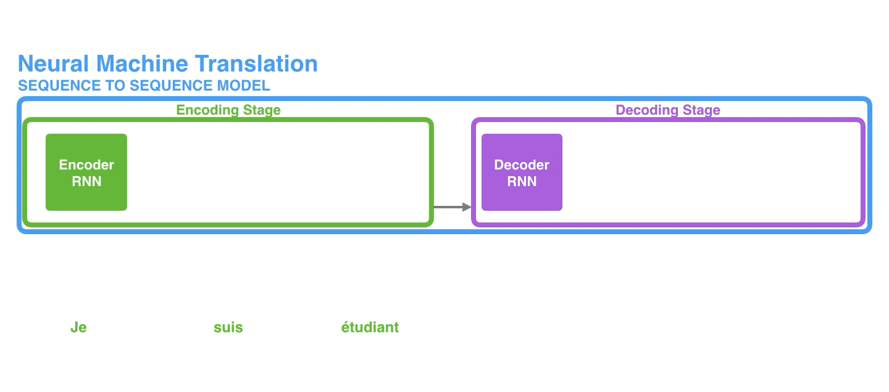
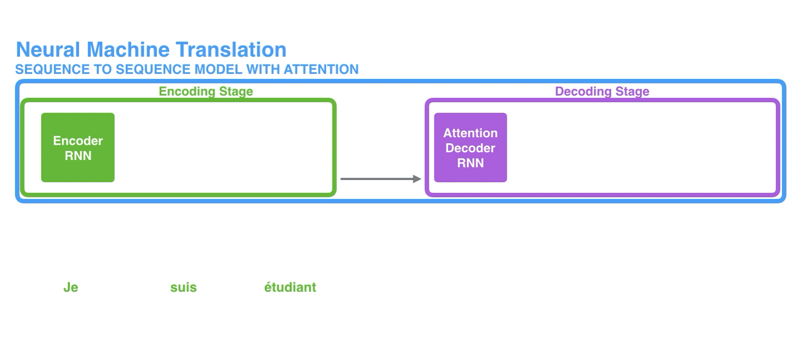
Attention is all you need
No Attention
With Attention

Slide 34
Self-attention
Traditional attention: between encoder and decoder, good for sequence-to-sequence task such as machine translation.
How about leveraging attention for learning representation?
-> ATTENTION with itSELF

Slide 35
Self-attention
FFNN
FFNN
FFNN
FFNN
embed
embed
embed
embed
This
is
our
bootcamp
*FFNN: Feedforward neural network

Slide 36
Self-attention
FFNN
FFNN
FFNN
FFNN
embed
embed
embed
embed
This
is
our
bootcamp
*FFNN: Feedforward neural network

Slide 37
Self-attention
FFNN
FFNN
FFNN
FFNN
embed
embed
embed
embed
This
is
our
bootcamp
*FFNN: Feedforward neural network

Slide 38
Self-attention
Previously we did one-head self-attention
FCNN
Self-attention
embed
This is our bootcamp

Slide 39
Multi-head self-attention
Q: How to create multi heads?
A: Just stack lah
Concatenate
FCNN
Self-attention
Self-attention
Self-attention
embed
This is our bootcamp

Slide 40
Multi-head self-attention
Multiple heads expand the model’s capability to focus on different parts of the sentence.
Improve the diversity of representation learning: each head tries to learn different representation subspaces of the input embeddings.

Slide 41

Are the issues resolved?
Information bottleneck : attention takes all input positions into account.
Slow, no parallelization : attention allows parallel computation (matrix multiplication).
Struggle to capture long-term memory : also related to resolve information bottleneck.

Slide 42
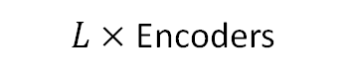
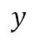
Transformer block
Embedding
Encoder
…
$L×$ Encoders
Encoder
Classifier
$$y$$

Slide 43

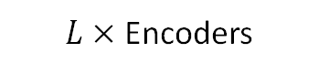
Transformer block
Embedding
Norm
Zoom +
Multi-head Attention
Encoder
…
+
$L×$ Encoders
Encoder
Norm
Feed-forward
Classifier
+
$$y$$

Slide 44
Transformer block
Norm
Multi-head Attention
Multi-head Attention
Concatenate
Zoom ++
+
Norm
FCNN
Self-attention
Feed-forward
Self-attention
Self-attention
+
Embeddings

Slide 45






Large language model (LLM)

Slide 46
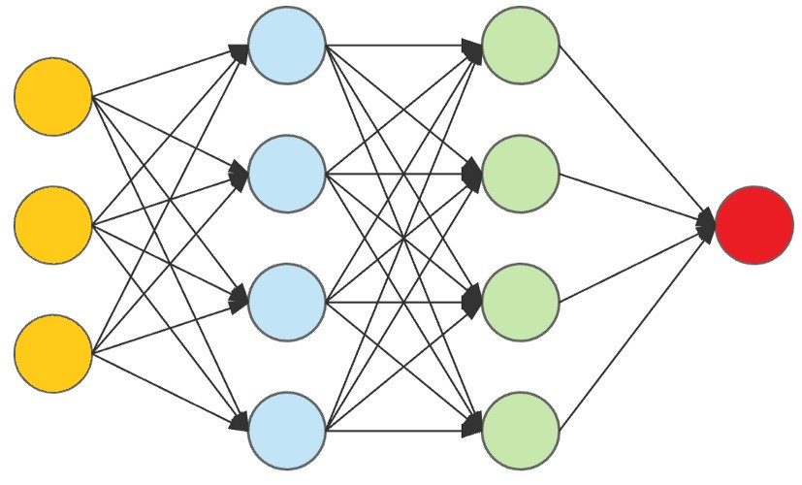
Large language model (LLM)
Where are we
going?
A language model
Task: next word prediction

Slide 47


Large language model (LLM)
HUGE number of parameters
HUGE data
HUGE computing power
More capacity for other tasks

Slide 48
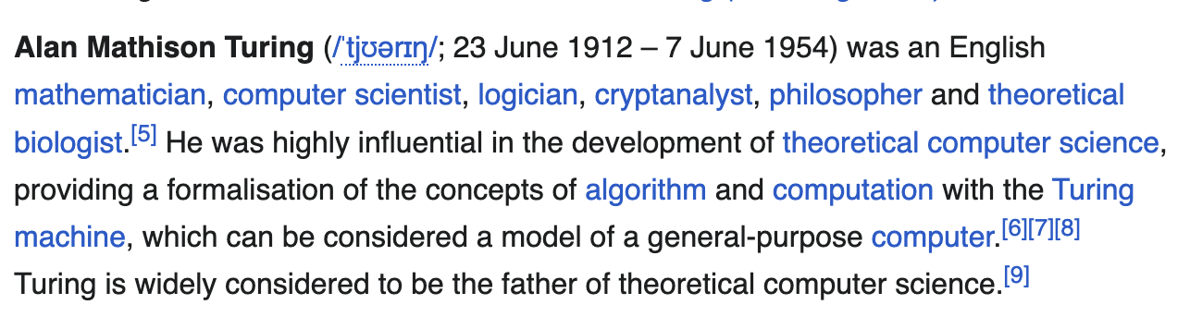
Large language model (LLM)
Next word prediction is powerful! - LLMs are forced to learn tons of knowledge during training.

Slide 49
Large language model (LLM)
Larger number of parameters
More nuanced language
Better at generation
However, it seems that next word prediction is not very useful for assistance task.

Slide 50


LLM – how to train?
train
Pretrained LLM
Fine-tune
Fine-tuned LLM
Task-specific data
Pretrained LLM
Base model
Assistant model
Large text data
Base model
Step 1: Pretrain on word prediction task -> base model (e.g. GPT-4)
Using huge text corpus (no label)
Costly
Done once in a while
Step 2: fine-tune base model on downstream task -> assistant model
Using LABELED task-specific dataset e.g. Q&A. Often smaller than text corpus.
Much cheaper
Fine-tune more regularly
Assistant model will be deployed for public use (e.g. ChatGPT, DALL-E)

Slide 51
LLM – a bird’s eye view
https://bbycroft.net/llm

Slide 52
GPT
Both BERT and GPT are transformer-based architectures
GPT is a generative model trained for Next Word Prediction
Great at generation, summarization, translation
Notes:
BERT is not generative. It is used for understanding the context of words in both directions, making it more suitable for tasks like question-answering and text classification.
So, for your domain-centric research, BERT may be a better fit
BERT uses the encoder segment of a transformation model. GPT uses the decoder segment of a transformation model. GPT is Autoregressive and unidirectional.

Slide 53
Are embeddings only for text?
Sentiment Analysis, Spam detection, Topic modeling
Named Entity Recognition
Text generation – autocomplete, summarization
Machine Translation
Information Retrieval, question answering
Image captioning
Image generation from prompt
MULTI - MODAL

Slide 54

CLIP embeddings
An image of a dog sitting in a field
An image of a dog sitting in a field
Notes:
Contrastive Language-Image Pretraining of 400 million (image + text) pairs
Search an image database using a description. Which is the movie where the actor does <>?

Slide 55
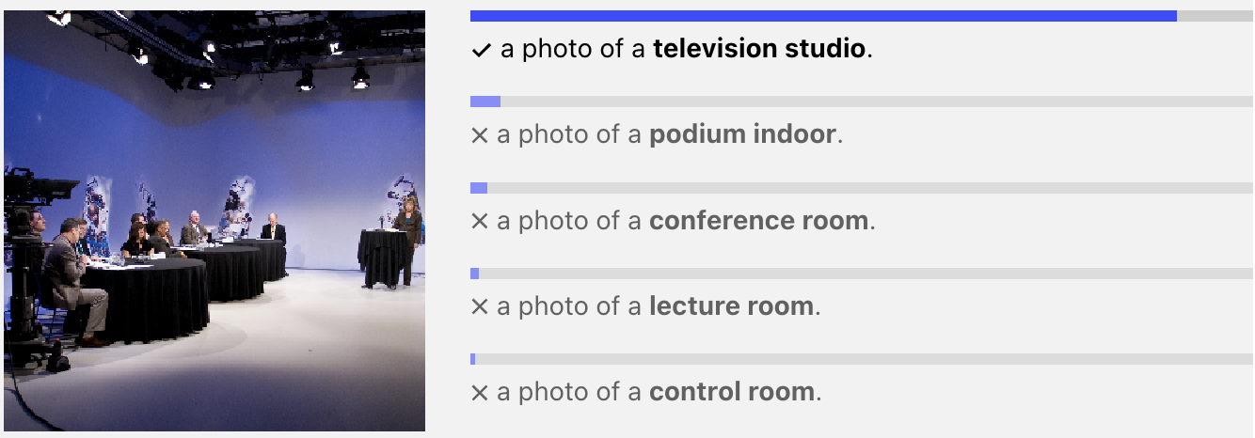
How can I use CLIP?
Task: Classification
TRAINING
CLIP caption
A photo of a {class label}
Image
INFERENCE

Slide 56
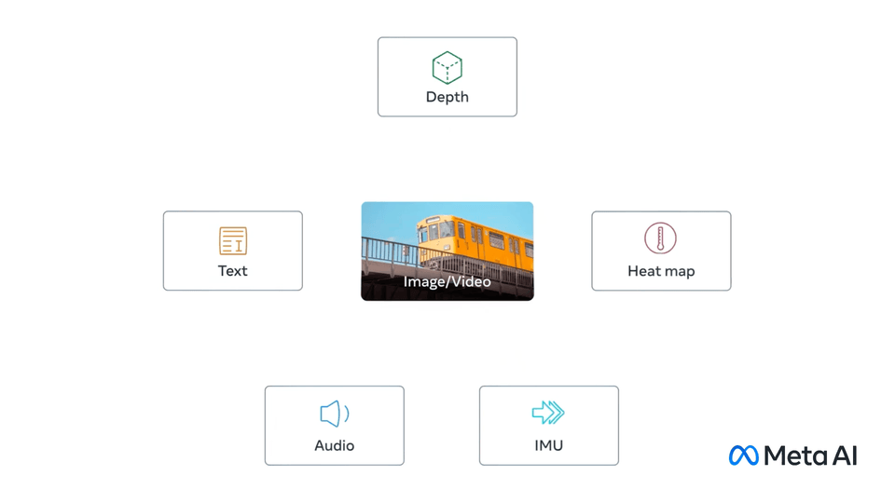
Multi-modal embeddings
Notes:
ImageBind

Slide 58


Slide 59

Session 5 : Reinforcement Learning

